Slide 1
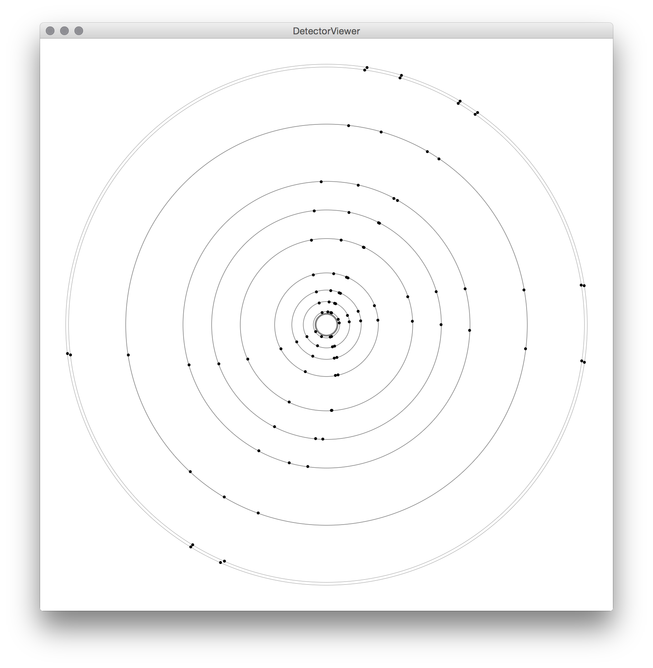
HL-LHC Track-Trigger Project for the ATLAS Experiment
Jared Vann
PHYS488

Slide 2
Outline
What is the ATLAS experiment and the HL-LHC proposed upgrade?
What is a Track-Trigger system and why it is needed?
The Java programming language.
Building the FieldLayer, DetectorViewer and Config classes.
Analysis of the effect of trigger resolution on efficiency.
Conclusion and potential simulation improvements.

Slide 3
ATLAS Experiment
What is it?
Versatile proton-proton collision particle detector.
Largest of the LHC particle detectors.
Inner detectors and calorimeters for detecting hadrons, photons and electrons.
Outer layers of detectors for detecting muons.
Inner 2 Tesla magnetic field from solenoid.
Future?
High Luminosity (HL) LHC upgrade: proposed factor of ~5 increase in beam luminosity.
Detector upgrades needed to handle increased collision events.
Notes:
What is it:
-Part of LHC
-CERN
Future:
-Recent upgrade provides more performance
-Diminishing returns

Slide 4
ATLAS Experiment

Slide 5
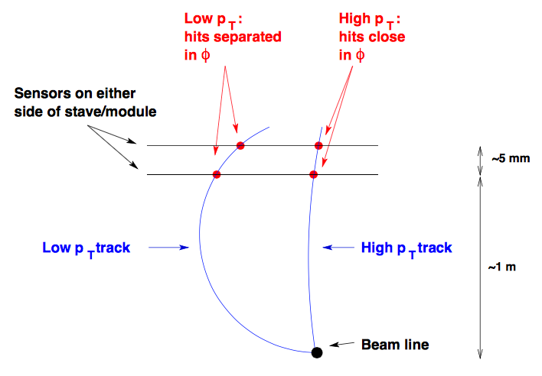
Trigger System
Why?
Present bunch crossing rate of 40MHz ≈ 1PB/sec of raw data.
Not enough data storage or computational power to collect data from every event.
Must choose most interesting events and discard the rest.
Event rate reduced to ~100Hz.
How?
Multiple levels of triggers to reduce data rate to acceptable levels.
Track-trigger would be part of muon L1 trigger.
Consists of two closely spaced concentric silicon detectors at ~1m radius.
Distinguish to a degree of accuracy between high and low energy muons.
Notes:
-Many events are uninteresting, noise
-Has to been done very quickly
-3 Trigger levels
-Data rate is reduced each time
-First stage 2.5 micro seconds
-Explain diagram

Slide 6
Java
Modern high level programming language.
Object orientated design.
C-like syntax.
Slower than C but far faster than languages like Python.
Large standard library makes it easy to perform a wide range of tasks.
Code can be run on many different platforms, eg. Windows, Mac, Linux.

Slide 7
Simulation Outline
Muons are simulated through a collection of layers that provide an approximation of the ATLAS inner detector.
All muons travel in the same plane perpendicular to beam line to allow simplifications to 2D.
Muon hits with the track trigger layers are recorded.
Muon momenta estimated from two detector hit position values.
These values are compared to actual muon momenta.
Track trigger and simulation parameters can be adjusted to find more optimal values.

Slide 8
Simulating Particles in Magnetic Fields
Region of detector simulated is in a constant homogeneous magnetic field perpendicular to the plane of muon travel.
Muons have charge, therefore interact with the field and travel in a circular motion.
Circle-circle path intersection approach attempted first.
Found it difficult to assure correct intersection point would be chosen for all possibilities.
Incremental step approach used instead.
Particle moved by discrete steps in direction of motion and direction of motion changed by a small angle many times.
x
x

Slide 9
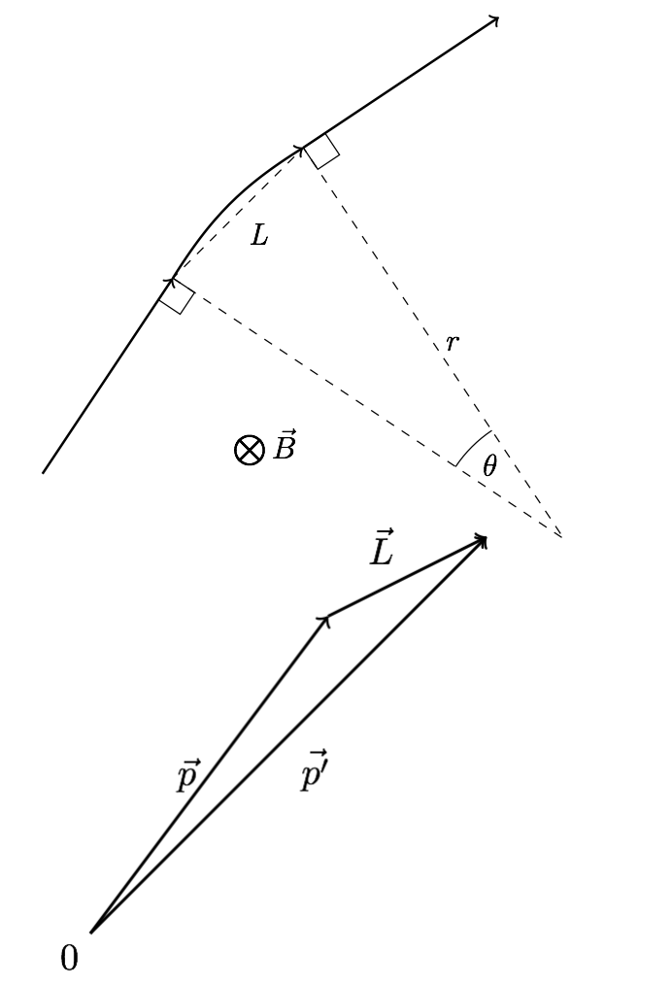
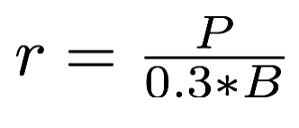
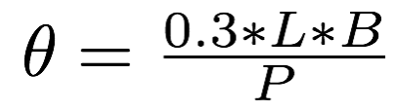
Simulating Particles in Magnetic Fields
Radius of particle motion trajectory given by: (P in GeV/c, B in Tesla)
Using trigonometry and the small angle approximation this can be rearranged to:
This is the angle the muon direction changes by over one step.
The change in position can be found by adding the original position vector p and the step vector L.

Slide 10
FieldLayer Class
public boolean handle(Particle p) {
double pX, pY, lX, lY, lTheta;
double pAzimuth = p.azimuth;
double pDirection = p.direction;
double pCharge = p.charge;
double stepSize = 10 * (end - start) / STEPS;
double theta = (stepSize*1000*0.3*field) / p.momentum;
pX = start * Math.cos(pAzimuth);
pY = start * Math.sin(pAzimuth);
for (int i = 0; i < STEPS; i++) {
lTheta = pDirection + theta*-pCharge/2;
lX = stepSize * Math.cos(lTheta);
lY = stepSize * Math.sin(lTheta);
pX = pX + lX;
pY = pY + lY;
pDirection = pDirection + theta*-pCharge;
if ((pX*pX + pY*pY) >= end*end) {
pAzimuth = Math.atan2(pY, pX);
p.setAzimuth(end, pAzimuth);
p.setDirection(pDirection);
return true;
}
}
return false;
}
Calculate the distance to move the particle through each iteration.
Calculate the angle to change the particle momentum direction by each iteration.
Convert particle position into Cartesian coordinates.
Calculate coordinates of L vector.
Add L vector to p vector.
Change particle momentum direction by θ.
Check if particle is still in layer.
Return true to let the simulation know to continue.

Slide 11
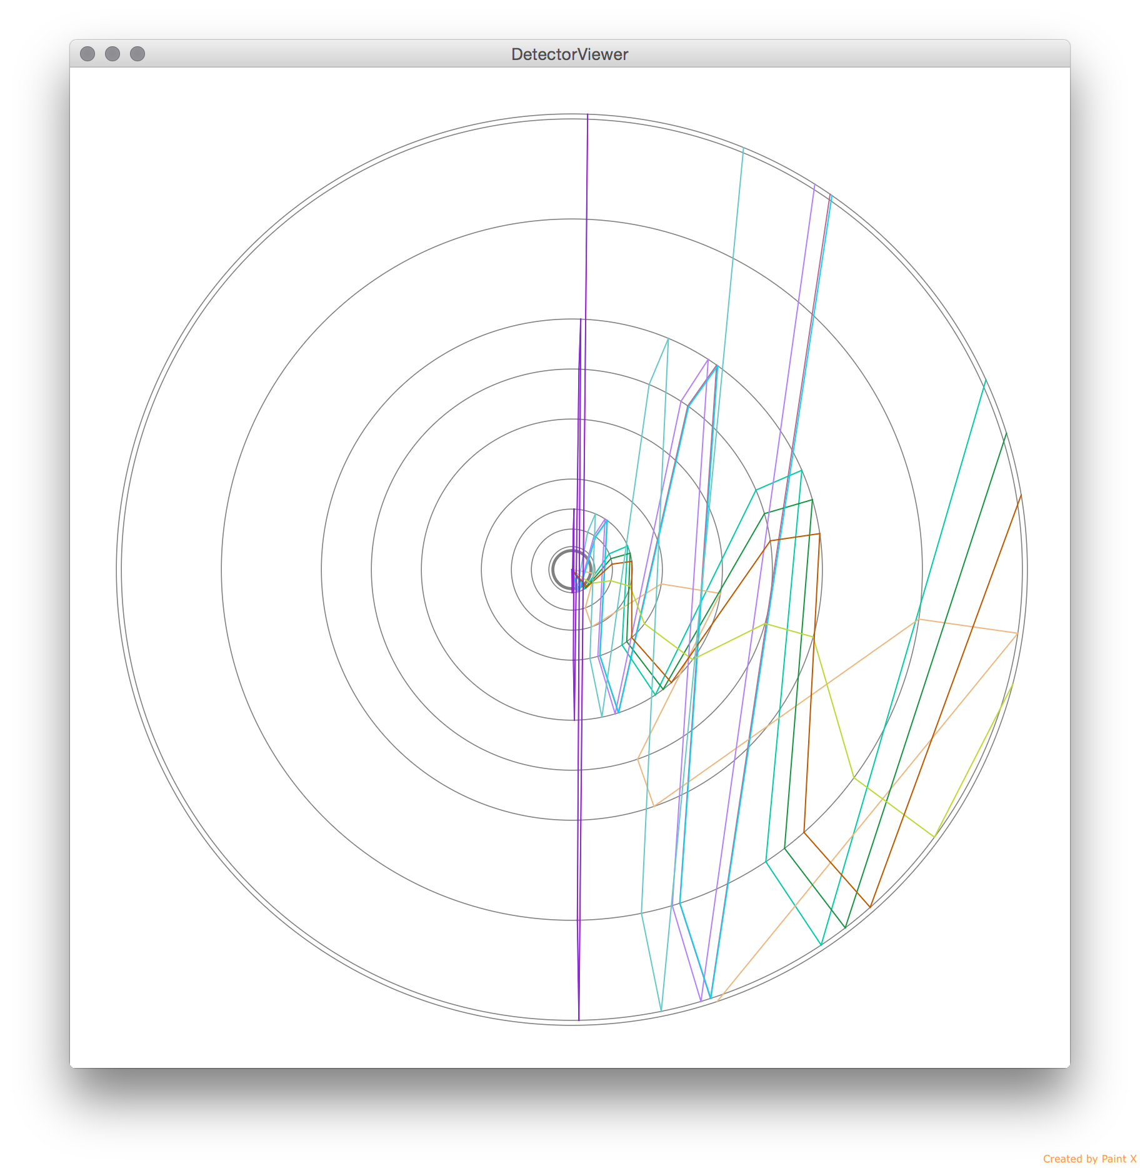
DetectorViewer Class
Before
Now
Notes:
Standalone program that displays simulation results of Muon paths through the detector.
Realised that it would be beneficial to see visually what paths are being simulated.
CSV data of points imported from main Simulation program.
Does not do any physics or analysis, purely diagrammatic.

Slide 12
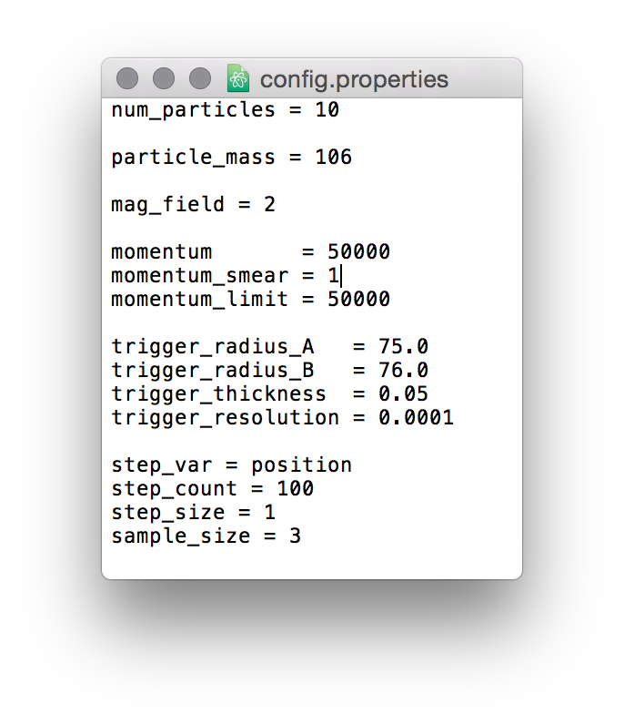
Configuration Class
Loads ‘properties’ file stored in the project directory.
Imports all keys and values of saved parameters.
Used by most classes to store values.
All parameters held in one easy to find place.

Slide 13



Simulation Workflow
Before:
After:
Decide on variable to change
in simulation
Decide on variable to change
in simulation
Edit variables across all code files
(Time consuming, prone to mistakes)
Edit variable in one single
config file
(Easy, hard to make mistakes)
Compile all Java files
(Time consuming)
Run Simulation
Run Simulation

Slide 14
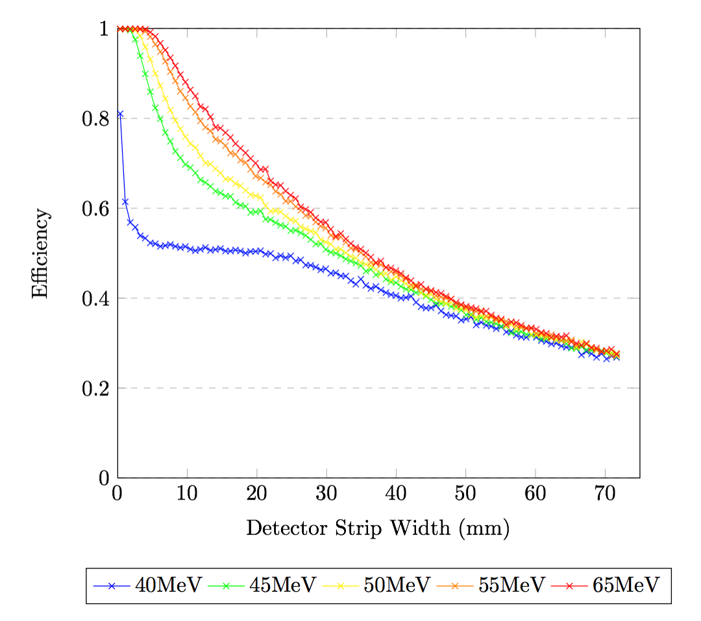
Simulation Tests
*Detector strip width values are approximate.

Slide 15
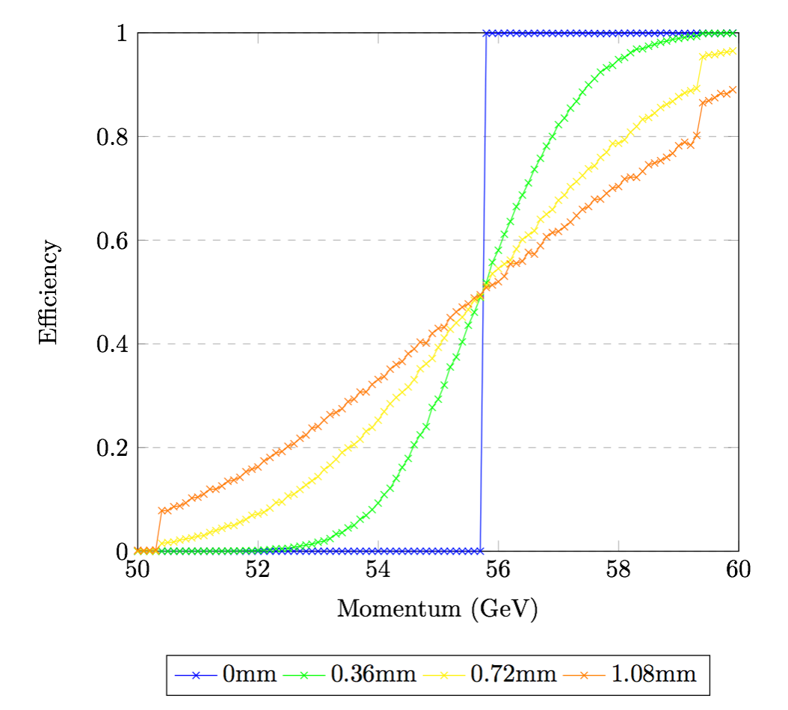
Simulation Tests
*Detector strip width values are approximate.

Slide 16
Conclusion and Improvements
Demonstrated the simulation of a particle through a magnetic field.
Demonstrated the effect of track-trigger resolution on efficiency for a range of momentum values.
Real conditions would have 100s of particles at once.
Would need to distinguish which hits belong to the same particle.
Real conditions would not achieve 100% efficiency.

